Slide 1
Introduction
Jaeseok Jang

Slide 2
Introduction
Statistics
A branch of mathematics dealing with the collection, analysis, interpretation, presentation and organization of data[Wikipedia]
Reasoning in an environment where one does not know, or cannot know, all of the facts needed to reach conclusion with complete certainty
Judgment and decision in situations of incomplete information
Probability theory
A branch of mathematics concerned with probability[Wikipedia]
The basis of for the science of statistical inference through experimentation and data analysis
Statistics and probability theory
A branch of mathematics that has been developed to deal with uncertainty

Slide 3


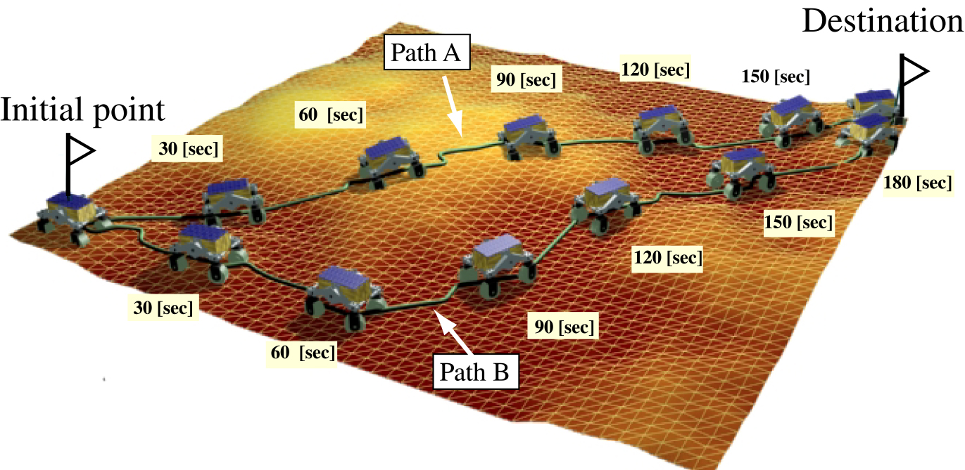
Applications

Slide 4
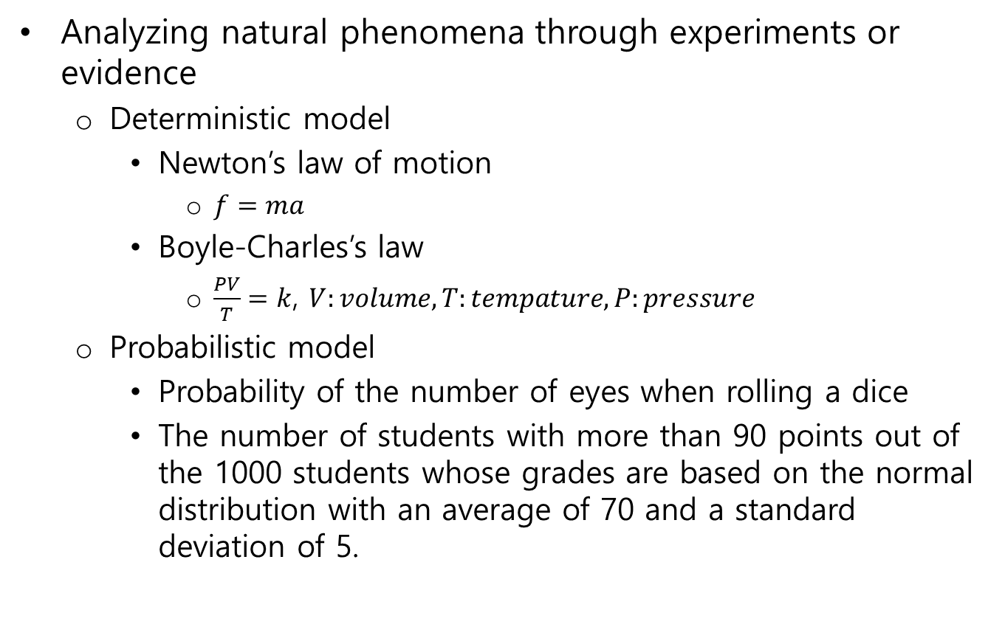
Mathematical Modeling
Analyzing natural phenomena through experiments or evidence
Deterministic model
Newton’s law of motion
$f=ma$
Boyle-Charles’s law
$\frac{PV}{T}=k$, $V:volume, T:tempature, P:pressure$
Probabilistic model
Probability of the number of eyes when rolling a dice
The number of students with more than 90 points out of the 1000 students whose grades are based on the normal distribution with an average of 70 and a standard deviation of 5.

Slide 5
Statistics
The study that presents methods for collecting data on objects of interest to organize, summarize, and make scientific judgments about uncertain facts.
Theoretical basis for the wider interpretation of the results of surveys on samples, especially those that are part of the population
Survey
Complete survey(whole investigation, a total inspection, complete observation, census)
A method of observation that examines the whole unit of statistical groups being affected
Sample survey
A statistical method that extracts from the population that is the subject of the study in a given way, and estimates the population based on the information they provide.

Slide 6
Statistics
Descriptive statistics
Identifying the characteristics of the data through the organization, expression, summary, or interpretation of the data collected in a measurement or experiment
Arranging of data into charts, tables, and graphs along with the computations of various descriptive numbers about data
Inferential statistics
A statistical methods used to estimate parameters from statistical models or to verify hypothesis

Slide 7
Statistics
Population
Sample extraction
Sample
Descriptive statistics
Descriptive statistics
Inferential statistics
Parameter
Statistics
Parameter estimation

Slide 8
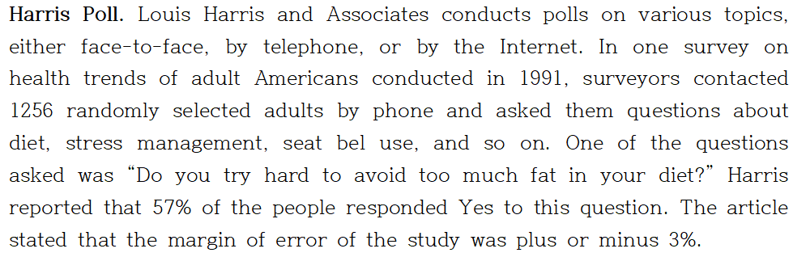

Sampling and Estimation
Group under study in this survey
Adult Americans $≥$ 200 millions people → population
1256 people → sample
People, things → unit, people → subjects
A characteristic of a unit → variable
Dichotomous(two possible values) or quantitative variable

Slide 9

Sampling and Estimation
A number derived from a sample → statistic
A number derived from the population → parameter
Population percentage of a dichotomous variable → $π$
Population mean of a quantitative variable → $μ$
Sample percentage $p$??
Population percentage $π$??

Slide 10
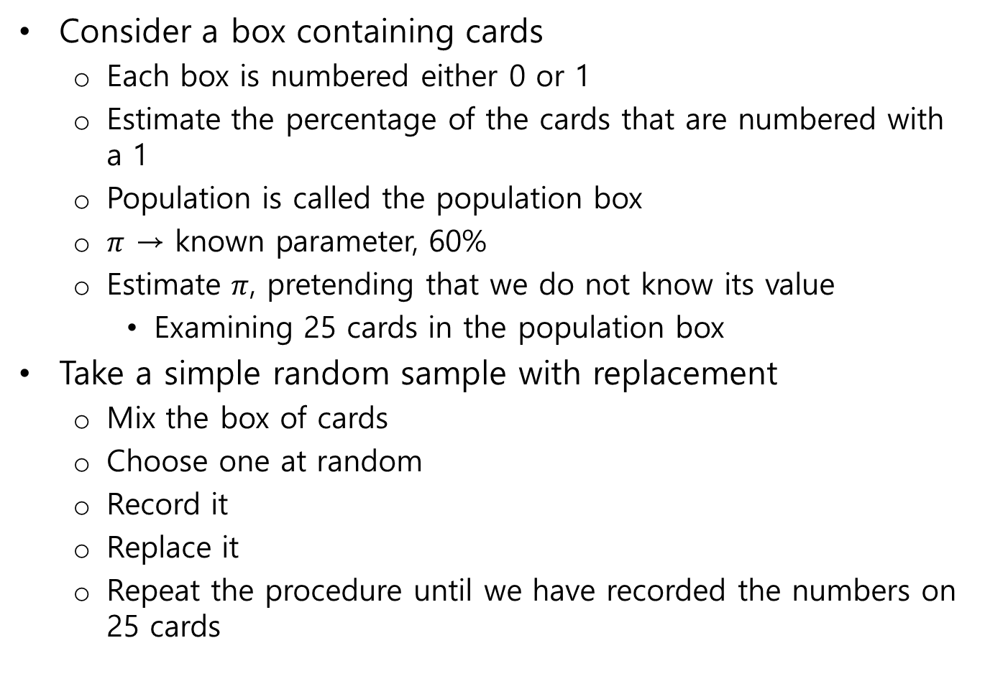
Simulation
Consider a box containing cards
Each box is numbered either 0 or 1
Estimate the percentage of the cards that are numbered with a 1
Population is called the population box
$π$ → known parameter, 60%
Estimate $π$, pretending that we do not know its value
Examining 25 cards in the population box
Take a simple random sample with replacement
Mix the box of cards
Choose one at random
Record it
Replace it
Repeat the procedure until we have recorded the numbers on 25 cards

Slide 11
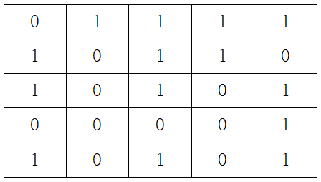

Simulation
Sample percentage $p$=14/25=0.56=56%
4 percentage points below the true population value $π$(60%)
Random sample error or random error

Slide 12
Error Analysis
An experiment
A procedure that results in a measurement or observation
In case of Harris Poll’s experiment
Measurement(statistic) → 57%
A random experiment
An experiment whose outcome depends upon chance
Execution or trial
Each repetition of the experiment

Slide 13
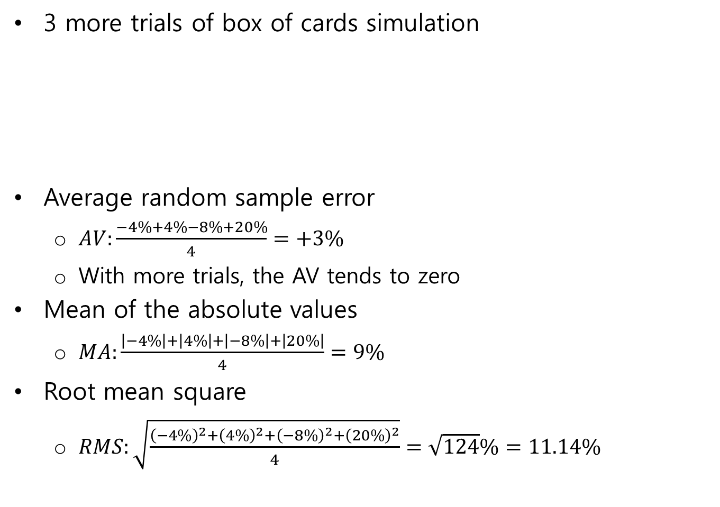
Error Analysis
3 more trials of box of cards simulation
Average random sample error
$AV:\frac{−4\%+4\%−8\%+20\%}{4}=+3\%$
With more trials, the AV tends to zero
Mean of the absolute values
$MA:\frac{\left|−4\%\right|+\left|4\%\right|+\left|−8\%\right|+\left|20\%\right|}{4}=9\%$
Root mean square
$RMS:\sqrt{\frac{{\left(−4\%\right)}^{2}+{\left(4\%\right)}^{2}+{\left(−8\%\right)}^{2}+{\left(20\%\right)}^{2}}{4}}=\sqrt{124}\%=11.14\%$
0 | 0 | 1 | 0 | 0
1 | 1 | 0 | 1 | 0
1 | 1 | 0 | 1 | 0
1 | 0 | 1 | 1 | 1
0 | 1 | 1 | 1 | 1
0 | 0 | 1 | 0 | 0
0 | 0 | 1 | 0 | 1
0 | 1 | 0 | 0 | 0
1 | 1 | 1 | 1 | 1
1 | 1 | 1 | 1 | 0
1 | 1 | 1 | 0 | 1
1 | 1 | 1 | 1 | 0
1 | 1 | 1 | 1 | 0
1 | 1 | 1 | 0 | 1
0 | 1 | 1 | 1 | 1

Slide 14
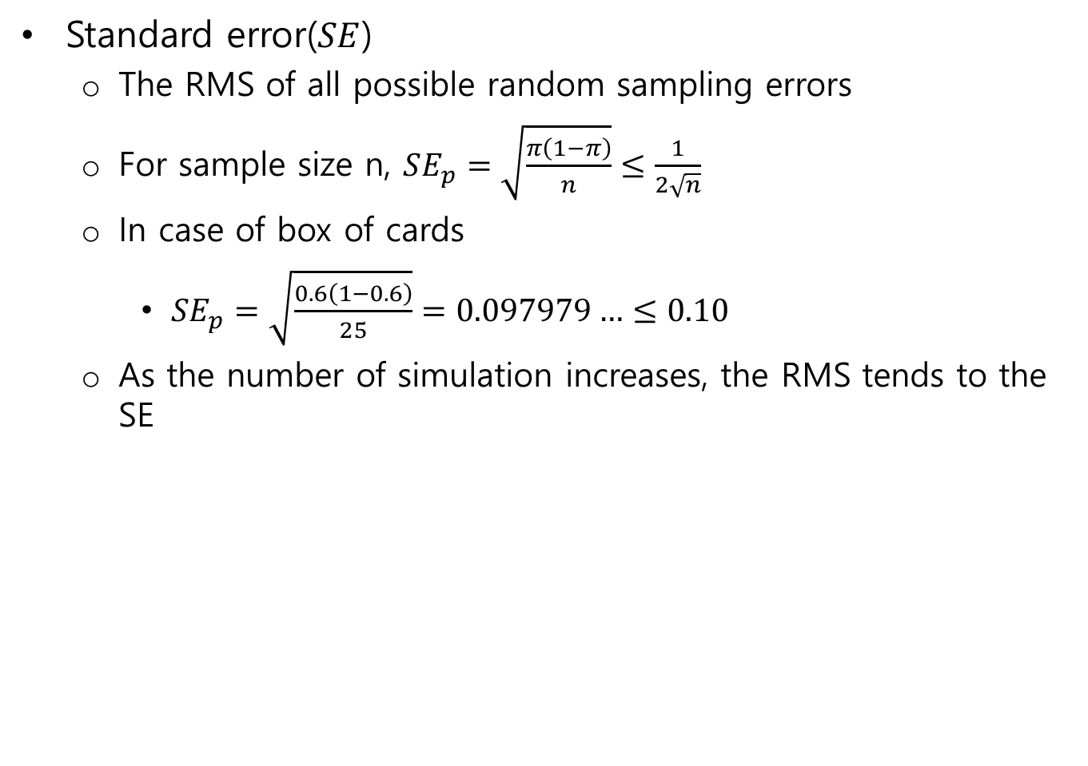
Error Analysis
Standard error($SE$)
The RMS of all possible random sampling errors
For sample size n, $SE_{p}=\sqrt{\frac{π\left(1−π\right)}{n}}≤\frac{1}{2\sqrt{n}}$
In case of box of cards
$SE_{p}=\sqrt{\frac{0.6\left(1−0.6\right)}{25}}=0.097979…≤0.10$
As the number of simulation increases, the RMS tends to the SE

Slide 15


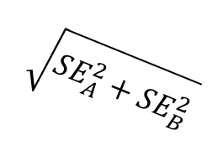

Error Analysis
Pythagorean property of measurement error
A is a measurement of a parameter $α$ with a $SE_{A}$
B is a measurement of a parameter $β$ with a $SE_{B}$
A+B is a measurement of $α+β$ with a $\sqrt{SE_{A}^{2}+SE_{B}^{2}}$
In error analysis, it is convenient to write
$A=α±SE_{A}$, $B=β±SE_{B}$, $A+B=α+β±\sqrt{SE_{A}^{2}+SE_{B}^{2}}$
$$\sqrt{SE_{A}^{2}+SE_{B}^{2}}$$
$$SE_{A}$$
$$SE_{B}$$

Slide 16
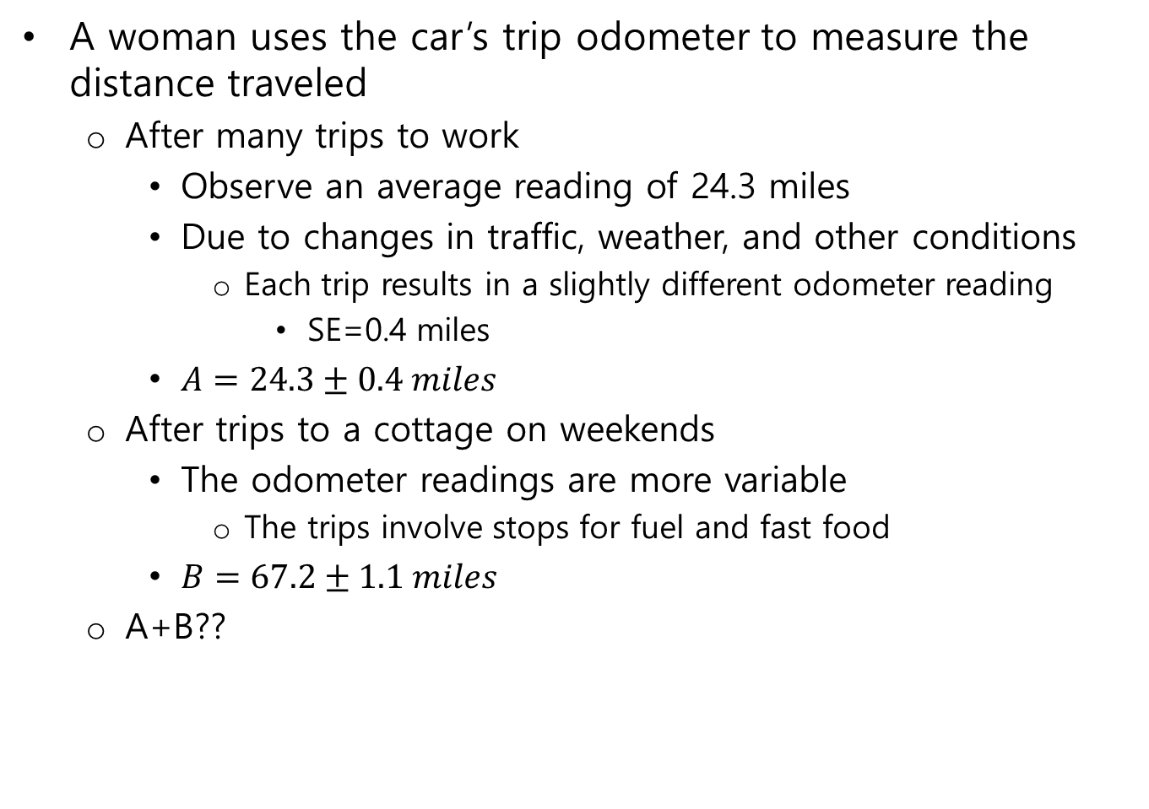
Error Analysis
A woman uses the car’s trip odometer to measure the distance traveled
After many trips to work
Observe an average reading of 24.3 miles
Due to changes in traffic, weather, and other conditions
Each trip results in a slightly different odometer reading
SE=0.4 miles
$A=24.3±0.4 miles$
After trips to a cottage on weekends
The odometer readings are more variable
The trips involve stops for fuel and fast food
$B=67.2±1.1 miles$
A+B??

Slide 17
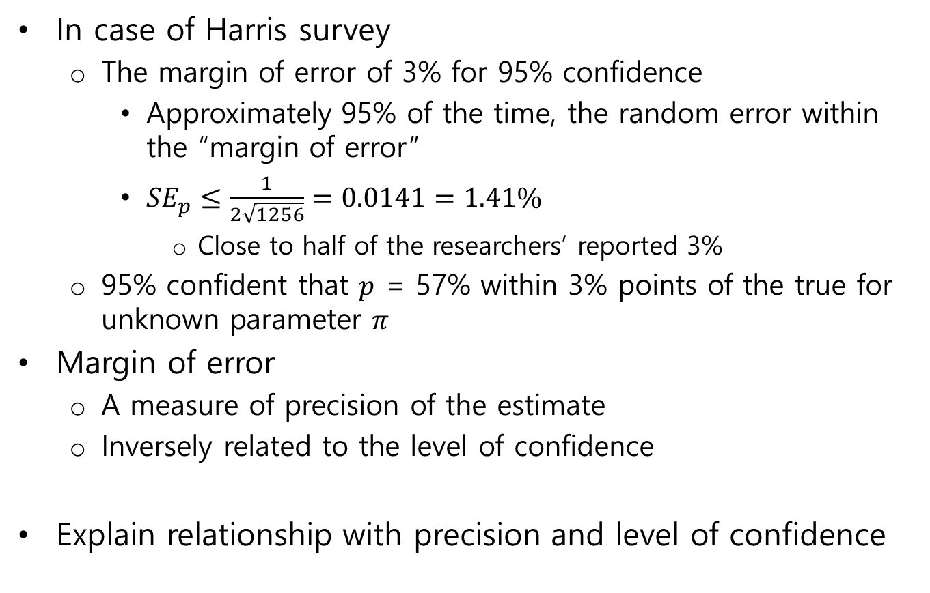
Precision vs. Confidence
In case of Harris survey
The margin of error of 3% for 95% confidence
Approximately 95% of the time, the random error within the “margin of error”
$SE_{p}≤\frac{1}{2\sqrt{1256}}=0.0141=1.41\%$
Close to half of the researchers’ reported 3%
95% confident that $p$ = 57% within 3% points of the true for unknown parameter $π$
Margin of error
A measure of precision of the estimate
Inversely related to the level of confidence
Explain relationship with precision and level of confidence

Slide 18
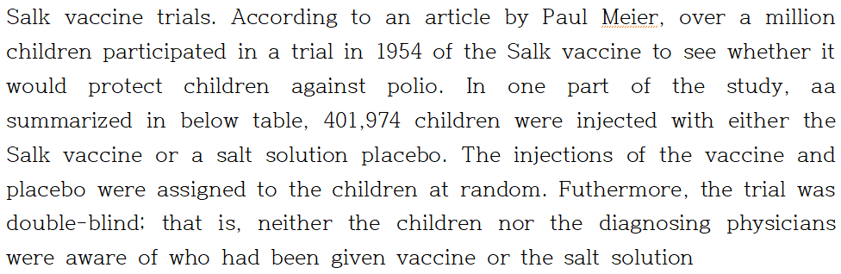
Hypotheses Testing
Group | Number of subjects | Fatal polio | Paralytic & fatal polio | Nonparalytic polio | Total case
Vaccine | 200,745 | 0 | 33 | 24 | 57
Placebo | 201,229 | 4 | 115 | 27 | 142
Totals | 401,974 | 4 | 148 | 51 | 199

Slide 19
Hypotheses Testing
Does Salk vaccine prevent death from polio??
Null hypotheses
The Salk vaccine was completely ineffective in preventing death from polio
Does it prevent paralytic polio??
33 were later diagnosed with paralytic polio compared with 115 of the children in placebo group

